Slide 1
BFX-AT100
Bottom cover bad weld line and bad gas mark / FA Report
Prepared by : SQE Peter
Date : 2024/05/21

Slide 2
#1
Description of Problems
Issue Description (5W2H)
When | 2024 May 17
Who | ALT customer
Where | SK networks warehouse, Anseong, Korea.
What | ALT customer feedback that they found out 1600/1600pcs product that bottom cover have bad weld line and bad gas mark.
Why | Bottom cover have bad weld line and bad gas mark (P/N: 442.00630.015, Injection DC: 2024.03.22, Vendor: NWEII)
How | Visual check => NG
How many | 1600/1600pcs ( F/R: 100%).
Notes:
MA5800-X7#display cable modem <MAC> detail

Slide 3
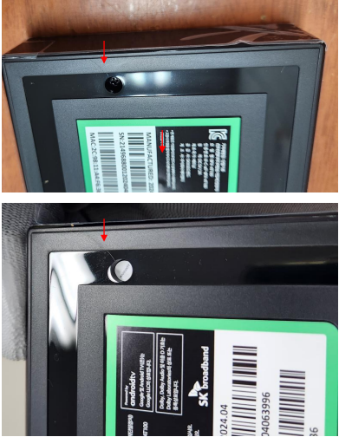
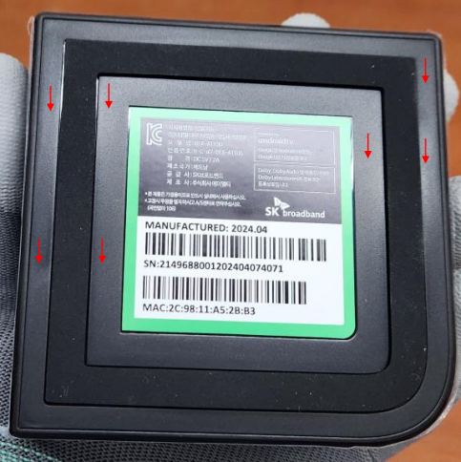
#2
Description of Problems
On May 17, 2024, T99X171.00 model, ALT customer feedback that they found out 1600/1600pcs product visual abnormal, bottom cover have bad weld line and bad gas mark
Defect rate: 100% (1600/1000 pcs)
Fail symptom: Visual check => NG
1. Bad gas mark
2.Bad weld line
Notes:
5.26891E-07 4.96855E-07

Slide 4
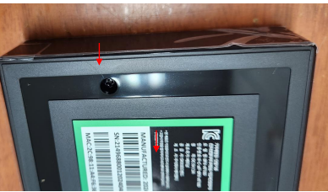
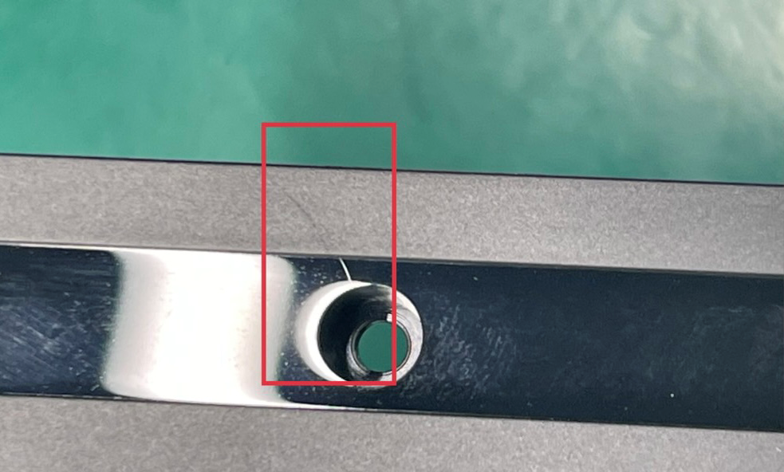
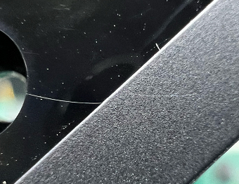
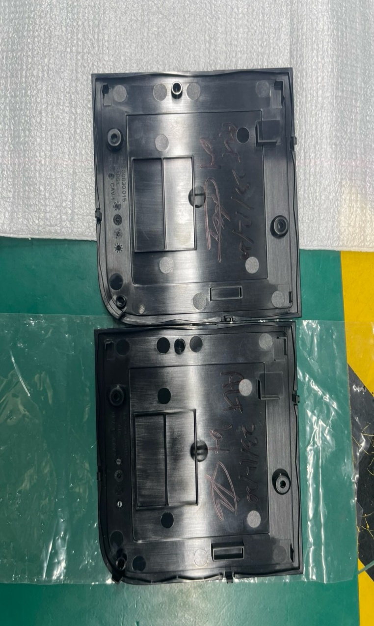
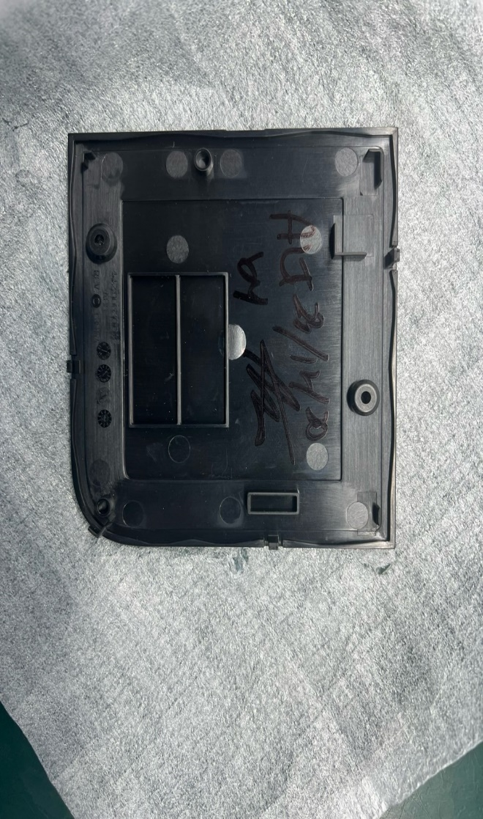
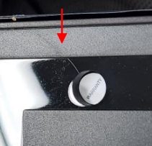
#3
Identify Root Cause – Preliminary analysis
1. Bad weld line
Data compared with ALT golden samples
ALT NG sample
NWEII Golden sample
Fii Golden sample
Summary:
- Recheck ALT inform defect issue with NWEII and Fii golden sample also have bad weld line. The same issue
Notes:
MA5800-X7#display cable modem <MAC> detail

Slide 5
#4
Identify Root Cause – Preliminary analysis
Root cause:
Bad weld line incoming material issue :
Bad weld line issue cause parting line within 2 mold during production, are all there on have 2 capities, 1 is clearly and 1 is dimmer. We also check golden sample and there are have same issue. => 100% rate.
Action:
NWE vendor will adjust the injection parameters on the next build , and verify in the next production batch.
Due date June-2024.
Notes:
MA5800-X7#display cable modem <MAC> detail

Slide 6
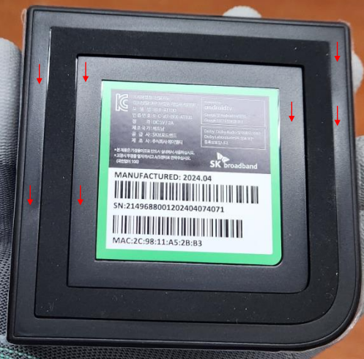
#5
Identify Root Cause – Preliminary analysis
2. Bad gas mark
With Bad gas mark issue, because neither NWE and FII can not find the problem, because we checked the materials online on the production line and the materials in the NWE warehouse, there were no problems as reported by customers. Therefore, may can we suggest that ALT send Defective samples back to Vietnam for us to analyze further.
Notes:
MA5800-X7#display cable modem <MAC> detail

Slide 7
#8
Conclusion
Root cause:
- Currently the machine is in production, bad weld line appear with blurred levels. When compare it with the golden sample that ALT signed for us to produce, it is the same.
This model, the actual product and production model are relatively similar. Currently, NWEII are manufacturing based on signed sampls. → Our side will train employees based on the model to produce and control this problem so that it does not become more serious.
- About bad gas mark, because can not see it clearly, so please help contact with ALT and ask ALT send the bad sample for analysis
Action:
➔
Notes:
MA5800-X7#display cable modem <MAC> detail

